Slide 1

NYC TAXI TRIP PREDICTION
By:D.SAFIYA
221fa14043
BI-3(A)

Slide 2
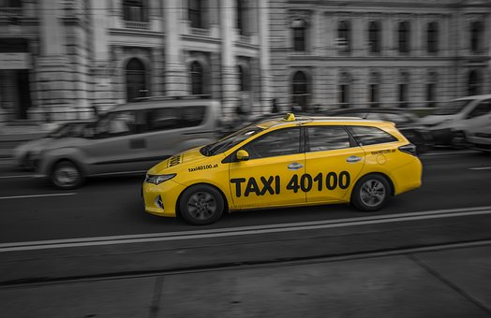
Presentation Outline
Main Objective
Data Source
Trip duration analysis
Data preparation and EDA
Feature Engineering
Correlation heatmap
Evaluation matrices
Summary

Slide 3

MAIN Objective:
Build a model that predicts the total trip
duration of taxi trips in New York City.

Slide 4
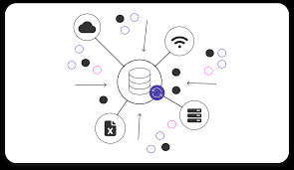
Data Source:
Source:NYC taxi data.csv
Statistics:
Rows - 1458644
Features - 11 (Including Target)
Target – Trip duration

Slide 5
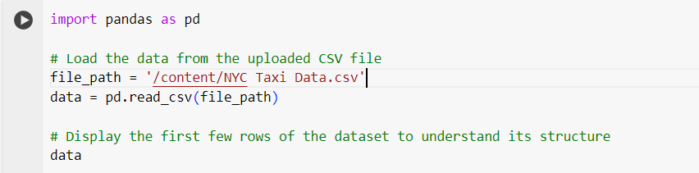
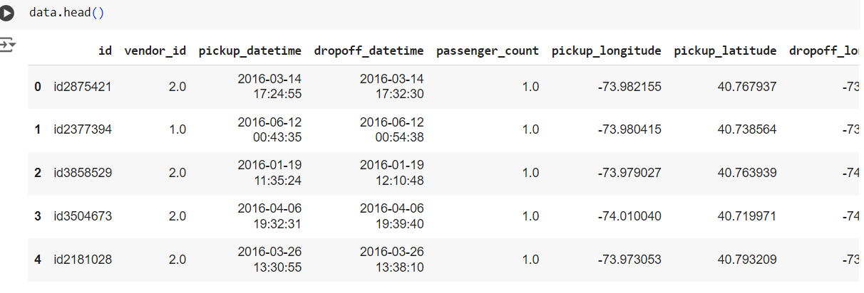
Data Preparation and EDA
First, begin with setting our path and importing required packages.
Now, Let’s read our dataset, we have some good amount of features in it.

Slide 6
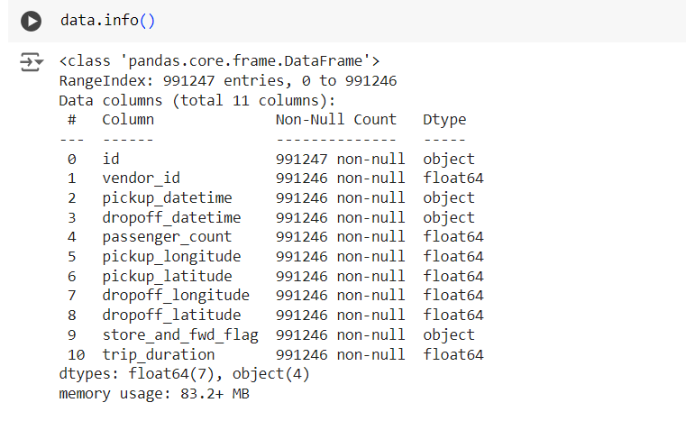
We have some features with “object” dtype and quite surprising to see that no Null Values.
Data fields:
id - a unique identifier for each trip
vendor_id - a code indicating the provider associated with the trip record
pickup_datetime - date and time when the meter was engaged
dropoff_datetime - date and time when the meter was disengaged
passenger_count - the number of passengers in the vehicle (driver entered value)
pickup_longitude - the longitude where the meter was engaged
pickup_latitude - the latitude where the meter was engaged
dropoff_longitude - the longitude where the meter was disengaged
dropoff_latitude - the latitude where the meter was disengaged
store_and_fwd_flag - This flag indicates whether the trip record was held in vehicle memory before sending to the vendor because the vehicle did not have a connection to the server - Y=store and forward; N=not a store and forward trip
trip_duration - duration of the trip in seconds

Slide 7
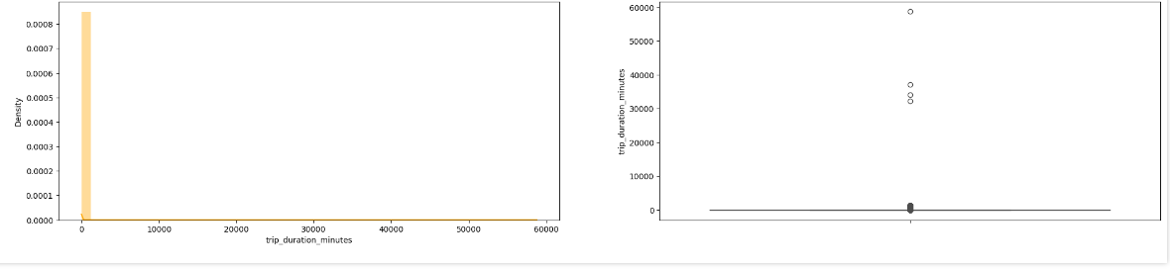
trip_duration analysis

Slide 8
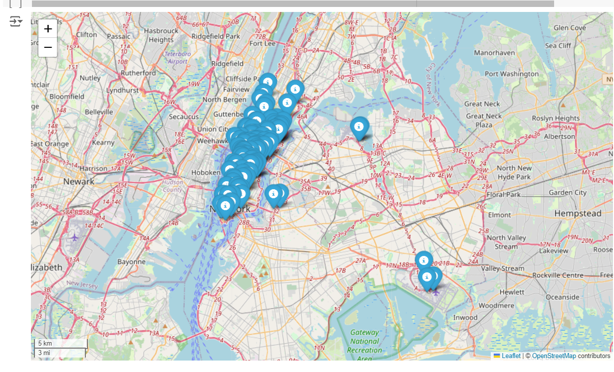
Distribution of Pickup Latitude and longitude

Slide 9
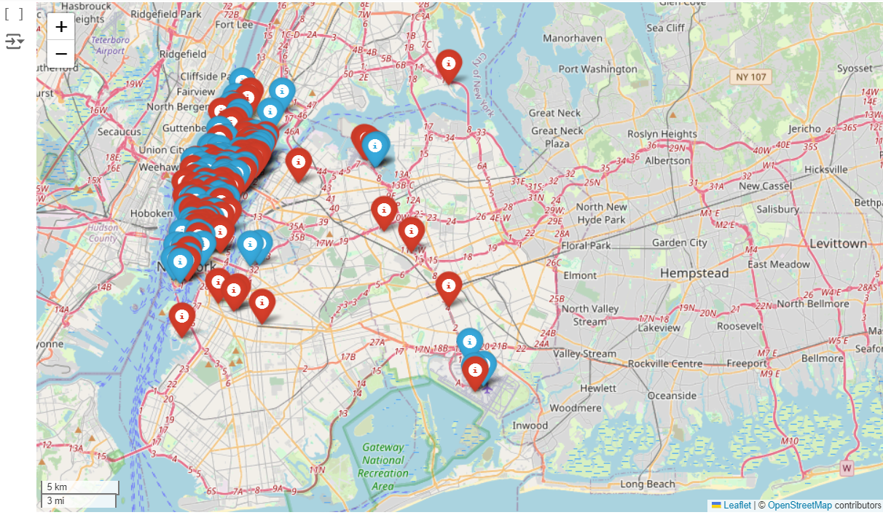
Distribution of Dropoff Latitude and longitude

Slide 10

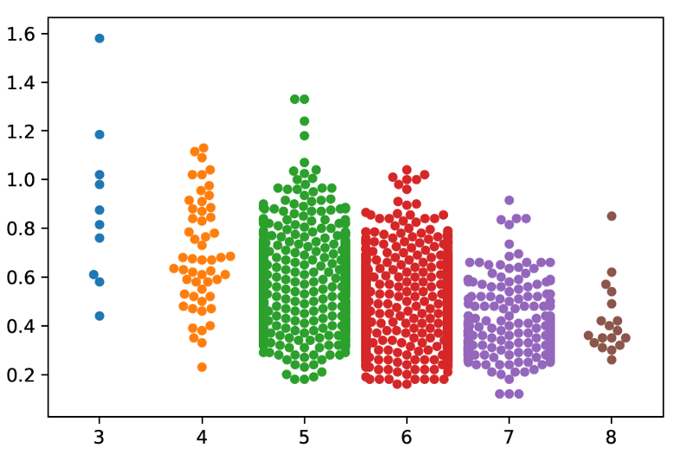

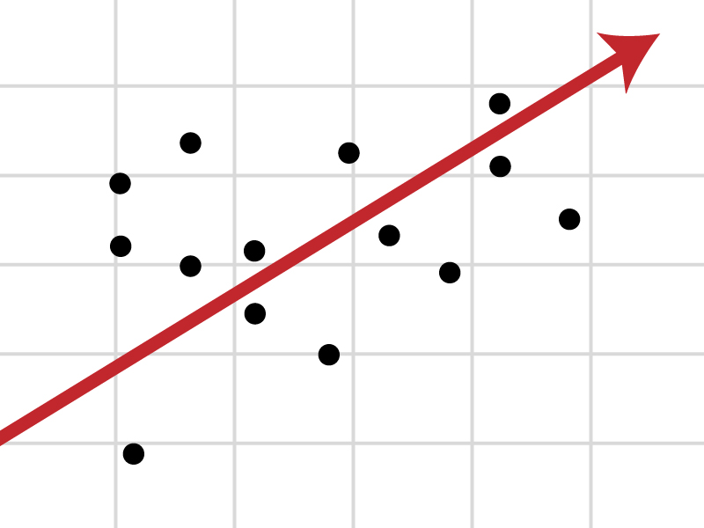
Approach
Data Preparation
and
Exploratory Data Analysis
Building Predictive Model
using Multiple
Techniques / Algorithms
Optimal Model Identified
through
Testing and Evaluation

Slide 11
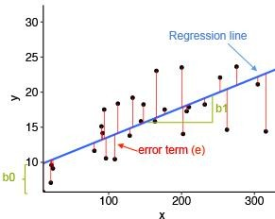
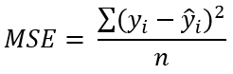
Linear Regression
Linear Regression is a regression of dependent variable on independent variable. It is a linear model that assumes a linear relationship between dependent
(y) and independent variables (x). The dependent variable (y) is calculated by l inear combination of independent variable (x).
y=b₀+b₁ x₁ +b₂x₂
The cost function for linear regression is given by:
Mean of sum of square error
MSE | 72764.0061
RMSE | 269.748041
R2 | 0.484766
Adjusted_R2 | 0.484758

Slide 12
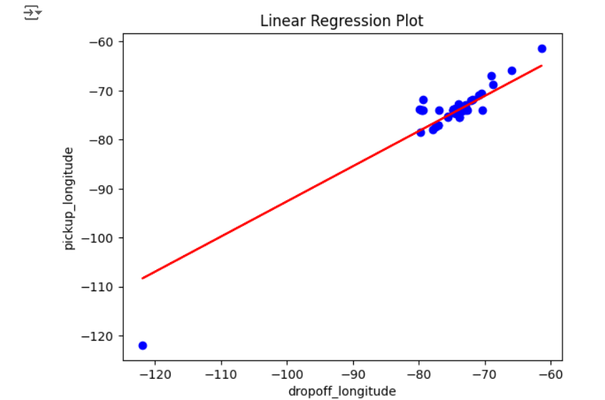
Linear regression :It mathematically models the unknown or dependent variable(pickup_longitude) and the known or independent variable(dropoff_longitude) as a linear equation.

Slide 13
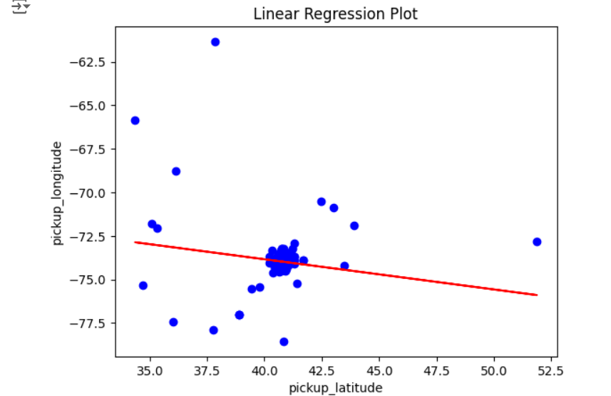
Linear regression :It mathematically models the unknown or dependent variable(pickup_longitude) and the known or independent variable(pickup_latitude) as a linear equation.

Slide 14
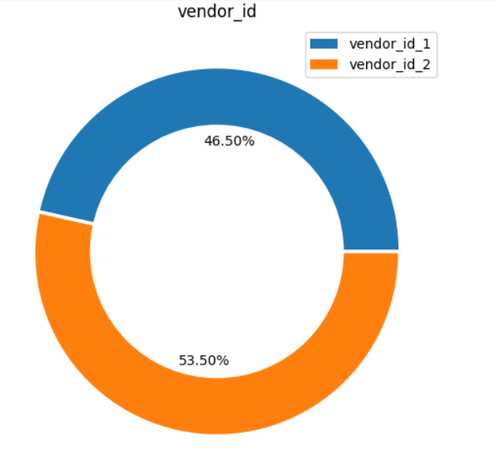
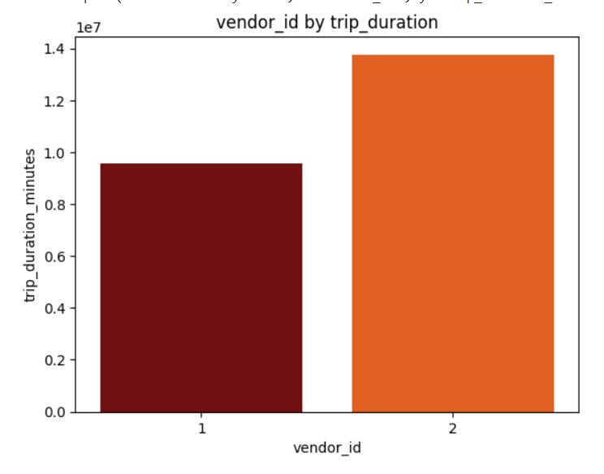
53.50% of the trips are completed by the vendor 2 and 46.50% of the trips are completed by vendor 1.
also maximum duration is covered by vendor 2

Slide 15
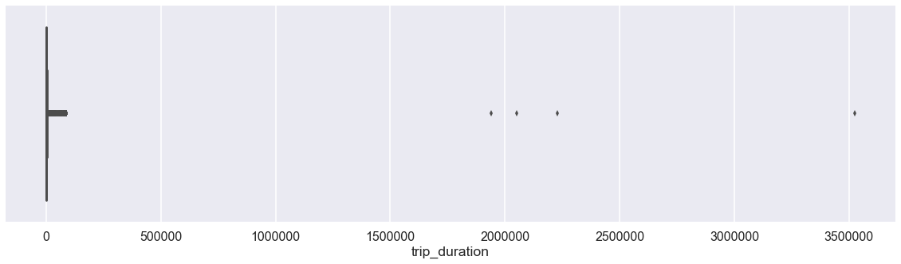
Trip Duration Viz.
Probably in this visualization we can clearly see some outliers (marked in Red) , their trips are lasting between 1900000 seconds (528 Hours) to somewhere around 3500000 (972 hours) seconds which is impossible in case of taxi trips , How can a taxi trip be that long ? It’s Quite suspicious. We’ll have to get rid of those Outliers or else it’ll affect our model’s performance.

Slide 16
Different Evaluation metrics
1) Mean Absolute Error(MAE)
MAE is a very simple metric which calculates the absolute difference between actual and predicted values.
2) Mean Squared Error(MSE)
MSE is a most used and very simple metric with a little bit of change in mean absolute error. Mean squared error states that finding the squared difference between actual and predicted value.
3) Root Mean Squared Error(RMSE)
As RMSE is clear by the name itself, that it is a simple square root of mean squared error.
4) R Squared (R2)
R2 score is a metric that tells the performance of your model, not the loss in an absolute sense that how many wells did your model perform.
5) Adjusted R2
Adjusted R2 is a corrected goodness-of-fit (model accuracy) measure for linear models. It identifies the percentage of variance in the target field that is explained by the input or inputs.

Slide 17
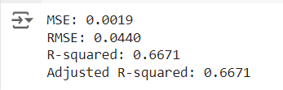
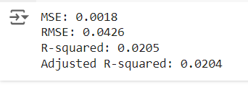
Evaluation metrics for Train set
Evaluation metrics for Test set

Slide 18
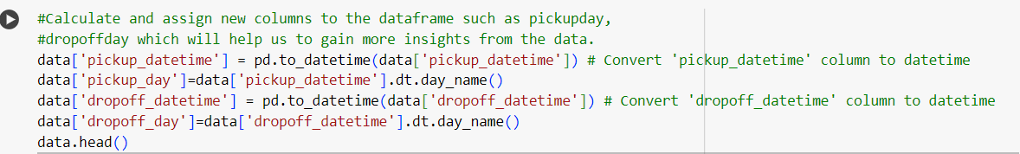
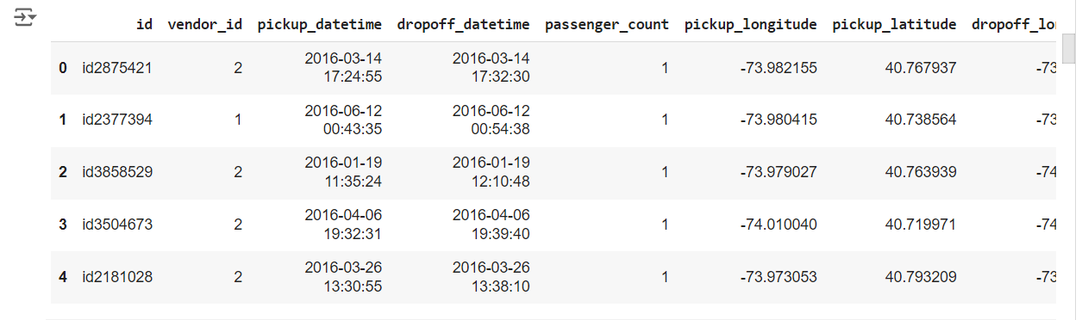
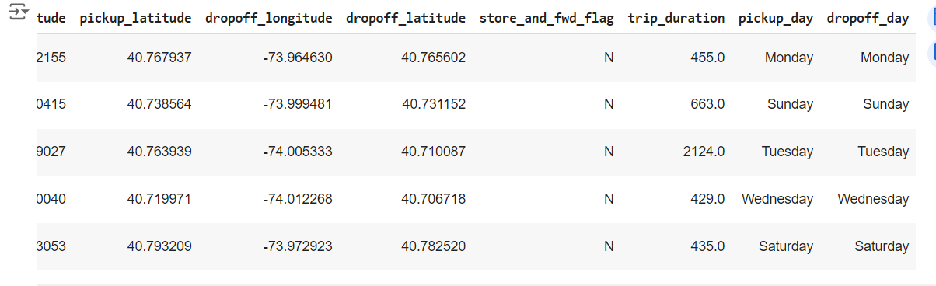
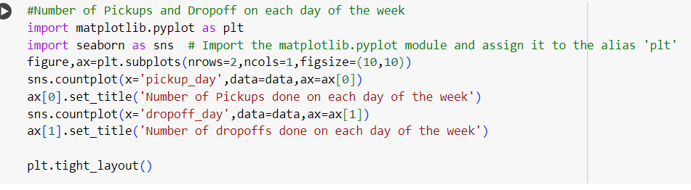
Feature Engineering
The Date and time columns in the Dataset has whole lot story to tell, we have to fetch them as separate columns. We do not have to fetch pickup and dropoff time both, as they may lead to strong positive correlation in the respective fetched features. Further we can use these columns for Analysis.

Slide 19
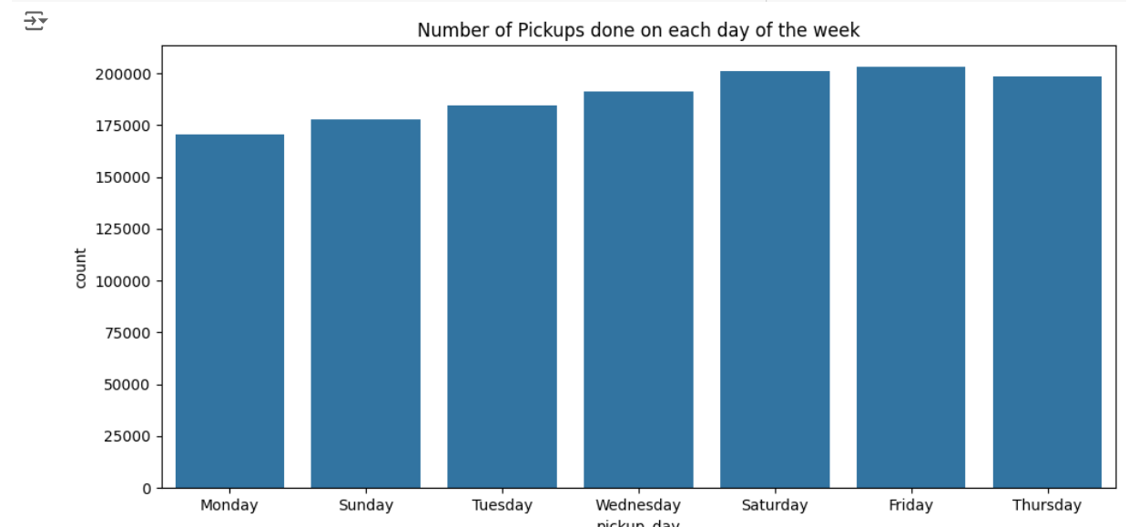
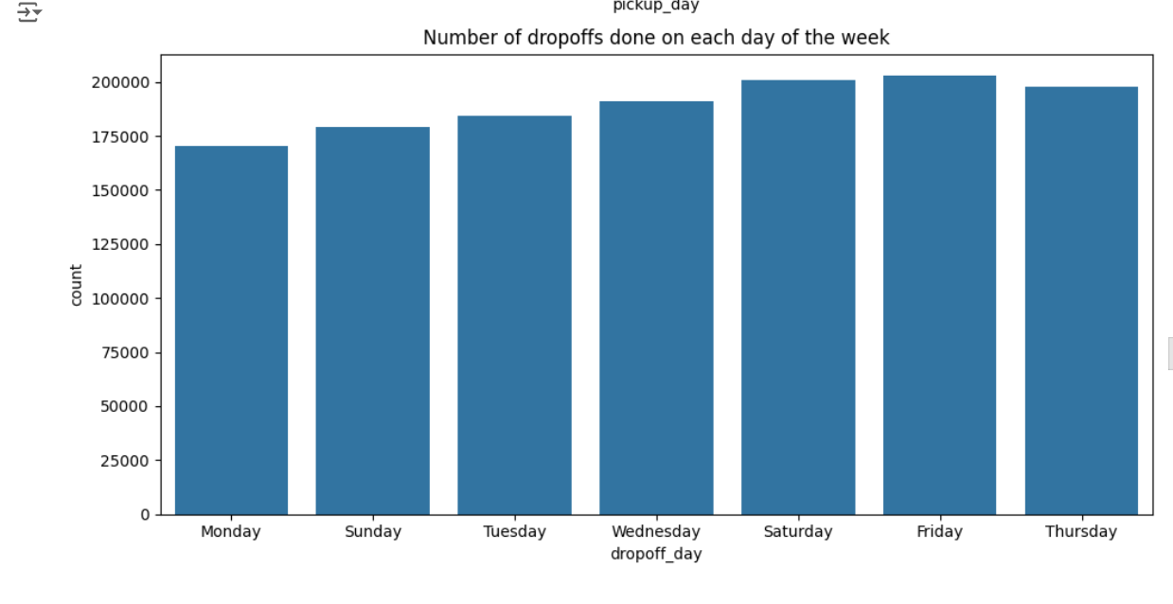
FEATURE ENGINEERING:
Feature engineering is a machine learning technique that leverages data to create new variables that aren’t in the training set. It can produce new features for both supervised and unsupervised learning, with the goal of simplifying and speeding up data transformations while also enhancing model accuracy.
Thus we see most trips were taken on Friday and Monday being the least. The distribution of trip duration with the days of the week is something to look into as well.

Slide 20
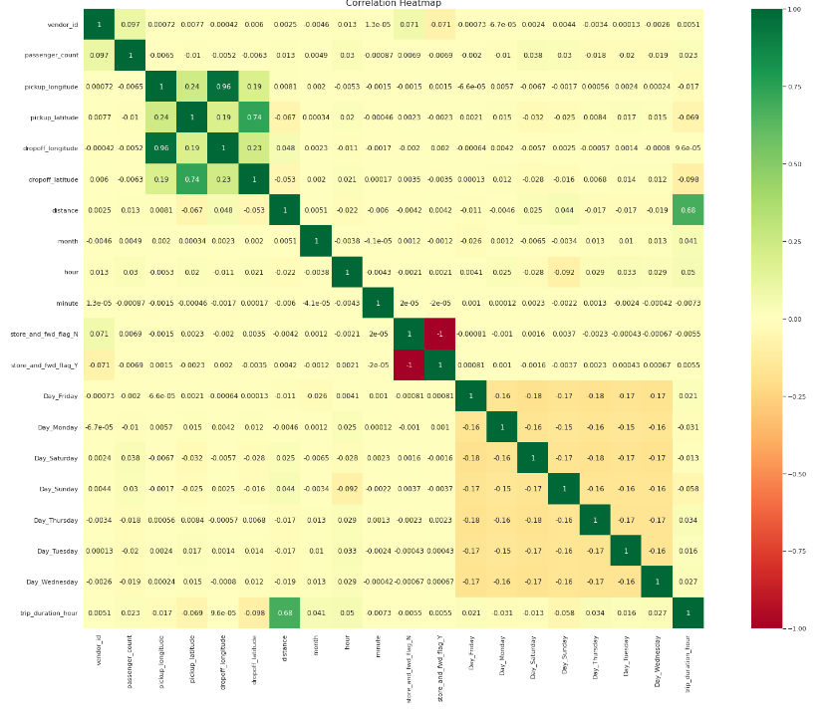
Correlation Heatmap

Slide 21
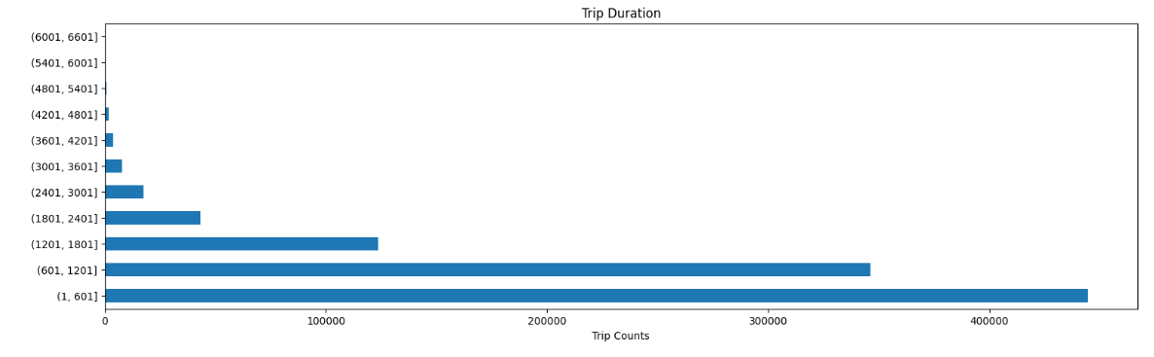
We can observe that most of the trips took 0 - 30 mins to complete i.e. approx 1800 secs.

Slide 22
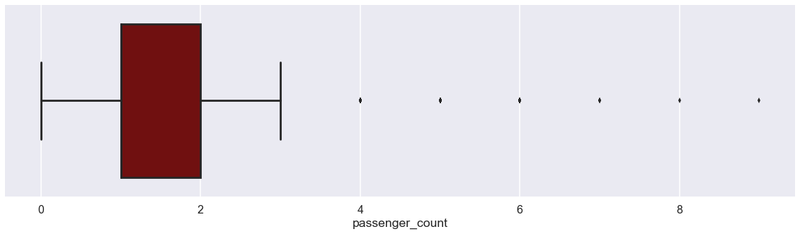
Most number of trips are done by single or double passengers.
But one thing is Interesting to observe, there exist trip with ZERO passengers, was that a free ride ? Or just a False data recorded ?

Slide 23
Conclusion:
In this project, we tried to predict the trip duration of a taxi in NYC.
We are mostly concerned with the information of pick up latitude and longitude and drop off latitude and longitude, to get the distance of the trip.
Hyperparameter tuning doesn’t improve much accuracy.

Slide 24

Beat me if you can !!

Slide 25
